Slide 1
Weekly Report
skyforce / RSEE4
2011/02/11

Slide 2
Color Engine - Status
Progress
HSV Refine 12/20~02/15
以sRGB為Target的調整量確認 (NTSC 45/60%) Done
Non-Linear V 調整公式修正 Done
硬體運算精確度度確認 Done
Saturation公式修正確認 01/31~02/15
Problem
Future Plan
HSV Simulation Model Implement 02/15~02/28

Slide 3
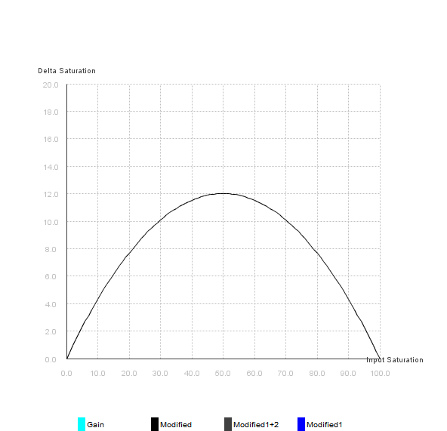
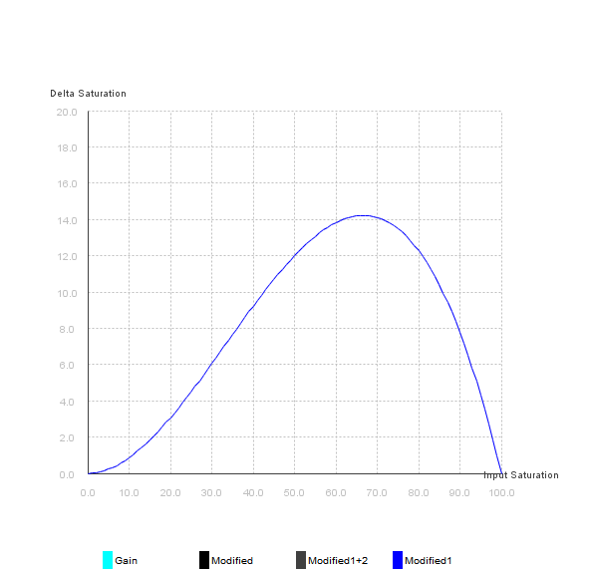
Saturation Refinement
Saturation Formula
Saturation’ = Saturation x Gain _{Saturation}
Saturation Clipping
以乘Gain值的方式, 當Gain >1 時, 必定造成後段clipping現象
Modified Saturation Formula
Saturation _{Normal} = Saturation / 100
Modified1(二次函數):
Saturation’ = Saturation + Offset _{Saturation} x Saturation _{Normal} x ( 1 - Saturation _{Normal} ) x 4
Modified2(三次:函數)
Saturation’ = Saturation + Offset _{Saturation} x Saturation _{Normal} x Saturation _{Normal} x ( 1 - Saturation _{Normal} ) x 8
採用Offset的方式, 減輕Clipping
強度調整, 確保最大值≒Offset Saturation
使調整公式為三次函數
二次函數
三次函數
Delta Saturation
Delta Saturation
Input Saturation
Input Saturation

Slide 5
 |  |  |  | 2010 Dec |  |  |  | 2011 Jan |  |  |  | 2011 Feb
List | Item | Start | End | 12/6 | 12/13 | 12/20 | 12/27 | 1/3 | 1/10 | 1/17 | 1/24 | 1/31 | 2/7 | 2/14 | 2/21
Dell Adjustment | Color Matrix | 12/6 | 12/16
 | Sharpness | 12/14 | 12/16
Color Engine | Color Matrix | 1/6 | 1/10
 | HSV | 12/20 | 1/28
 | - 以sRGB為Target的調整量確認 (NTSC 45/60%) | 12/31 | 1/2
 | - Non-Linear V 調整公式修正 | 1/3 | 1/6
 | - Non-Linear Saturation修改必要性評估 | 1/7 | 1/13
 | -硬體運算精確度度確認 | 1/14 | 1/20
 | -新調整機制實作 | 1/21 | 1/28
 | HSV Model Implement | 1/31 | 2/28

